Slide 1
Financial Performance Analysis: Western Countries Case Study"
A Capstone Project Demonstrating Data Cleaning, Statistical Analysis, SQL Queries, and Power BI Dashboards"

Slide 2
Explore the Data using Excel . Understand the data and prepare a short summary about the dataset.
This dataset shows product sales in different countries for the year 2013, 2014. It includes details like segment, product name, units sold, sales price, and profit. It helps track how much was sold, how much it cost to make, and the profit earned. Each row is a sales transaction with its date and country. It can be used to analyze sales trends, performance, and profitability.

Slide 3
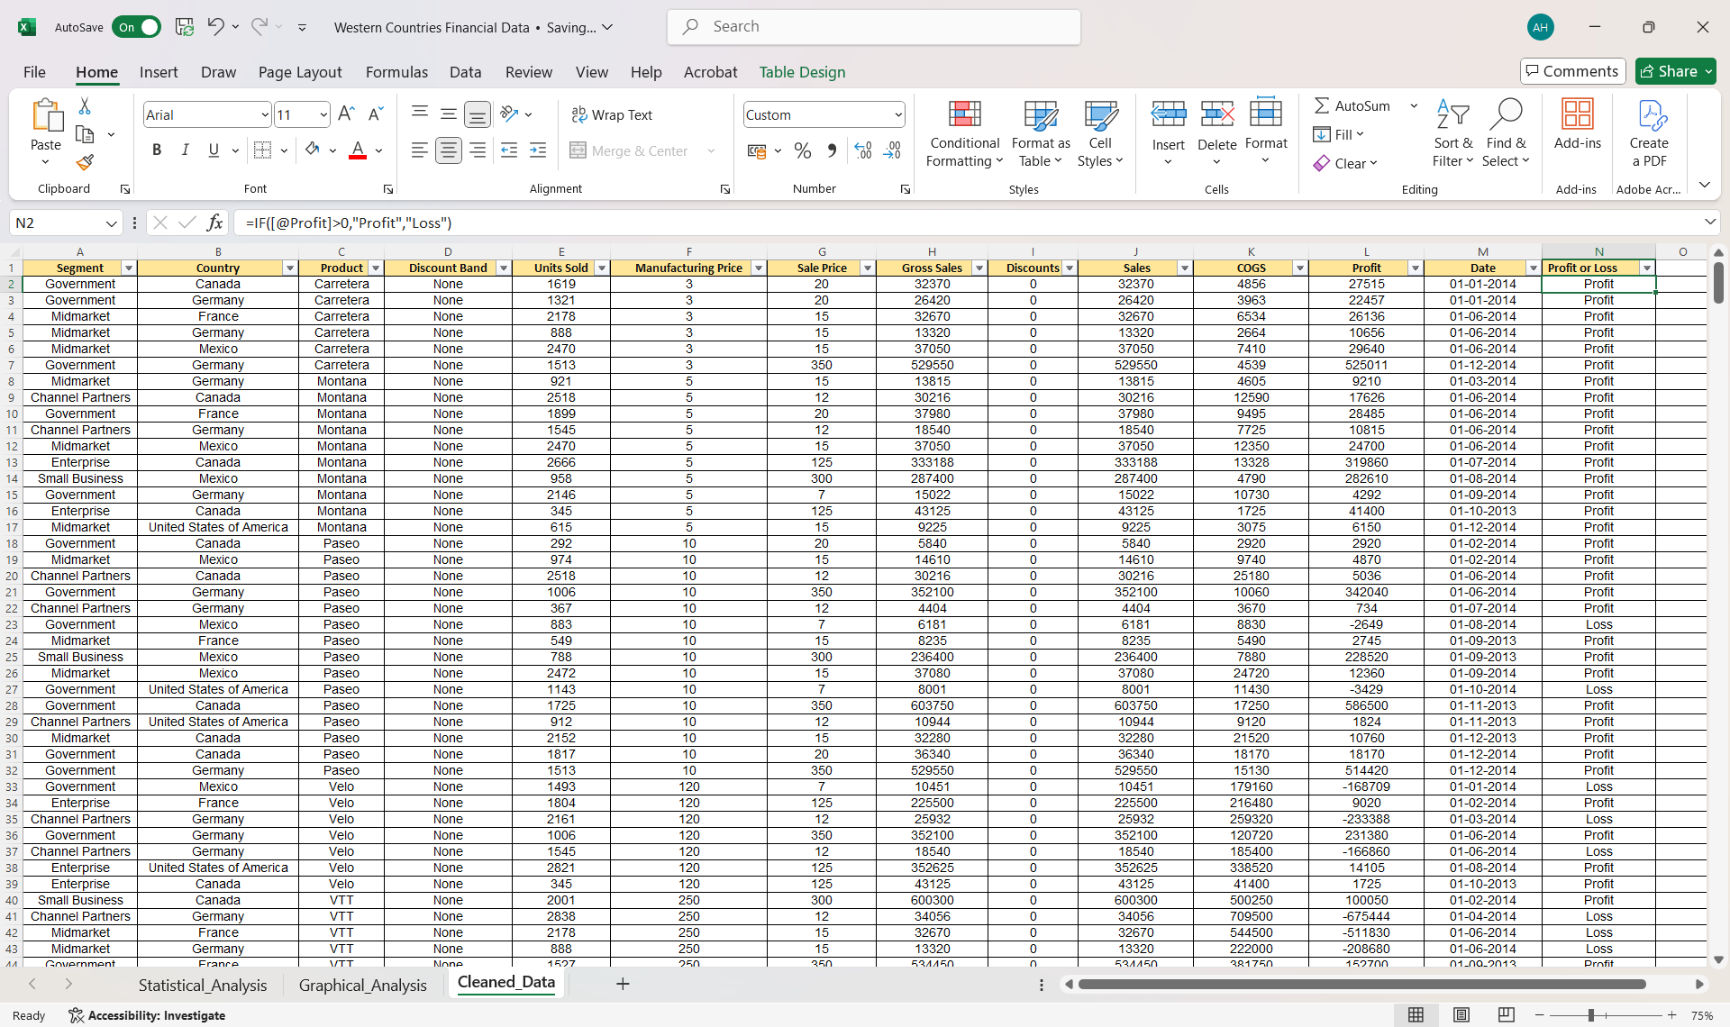
Perform Data cleaning if required and then do Statistical Analysis on data using statistical tools.

Slide 4
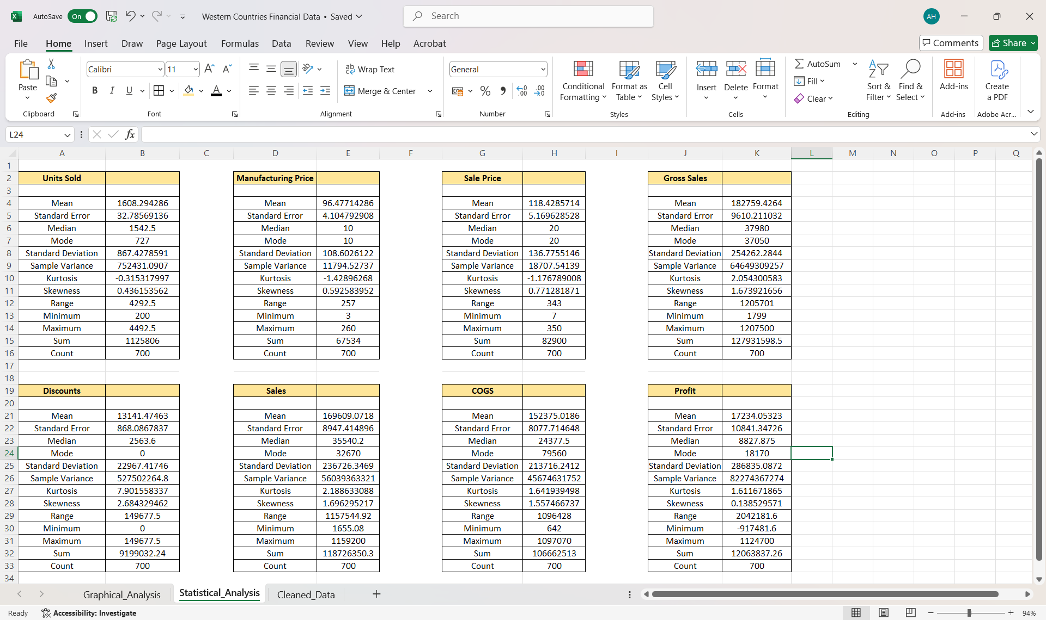
Perform Data cleaning if required and then do Statistical Analysis on data using statistical tools.

Slide 5
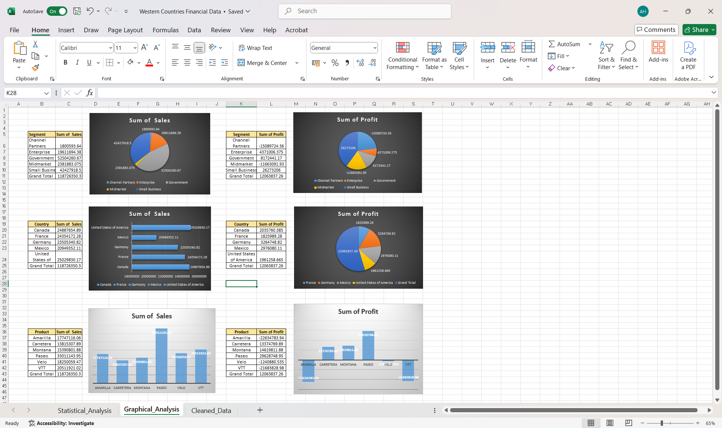
Perform Graphical Analysis on the Data using Excel and Derive insights from it.

Slide 6
The Enterprise segment has the highest sales and strong profitability, while Government delivers high margins despite the lowest sales.
Partners and Midmarket segments are heavily loss-making, indicating strategic or cost issues. The USA records the highest sales but has a lower profit margin, suggesting high operational costs or discounts.
France achieves the best profitability despite lower sales, showing efficient cost management. Mexico and Germany also perform well, with healthy profit margins.
Paseo is the top-selling and most profitable product, contributing significantly to overall gains.
Montana has a small profit, while Amarilla, Carretera, Velo, and VTT suffer losses.
Amarilla and VTT have the largest losses among products, requiring urgent corrective action.
The gap between high sales and low profit in some areas suggests the need for margin improvement strategies.
Overall, focusing on profitable segments, countries, and products while reducing losses in underperforming areas can boost profitability.

Slide 7
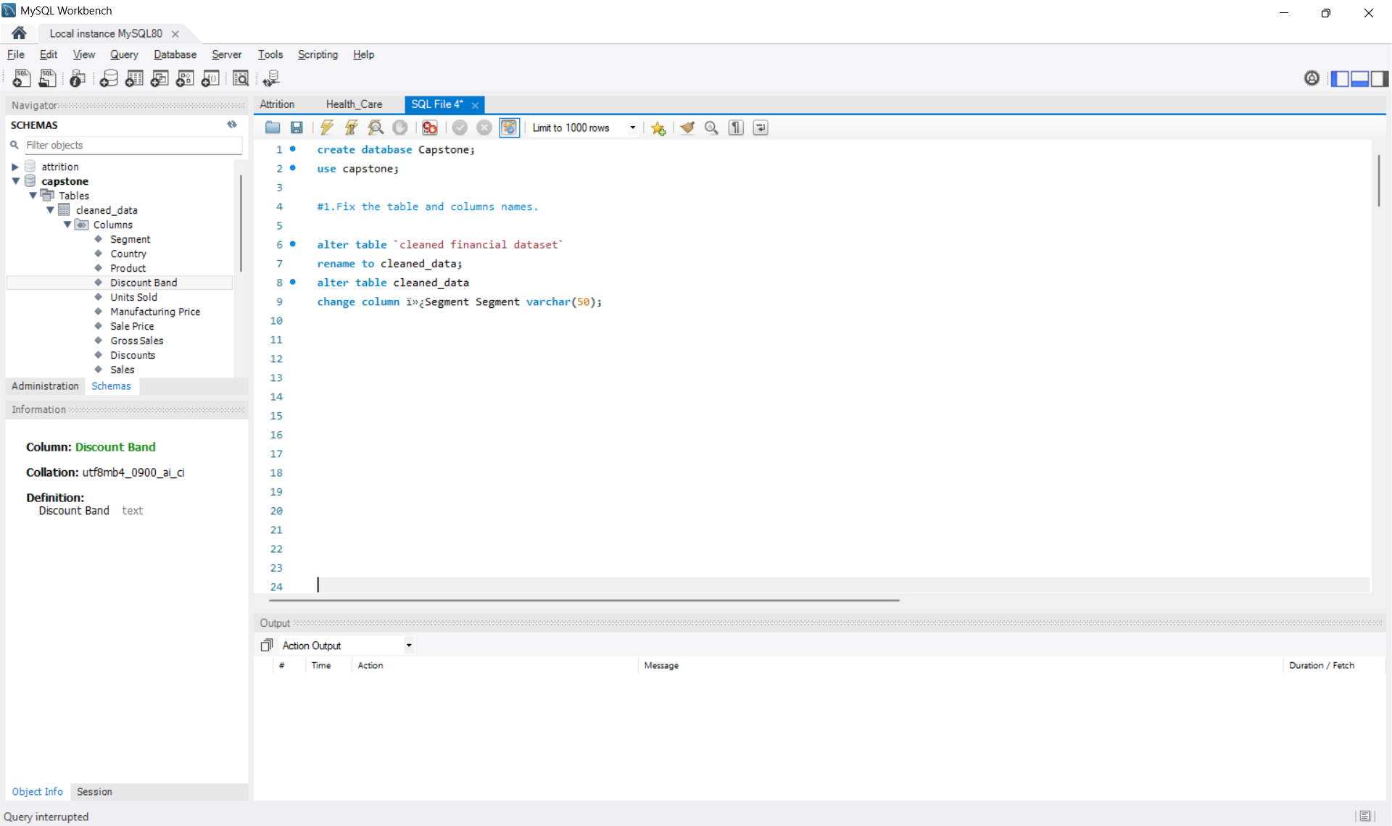
Insert the given data into the SQL server by making a Database and defining there Required parameters for the construction of Database and Database tables.

Slide 8
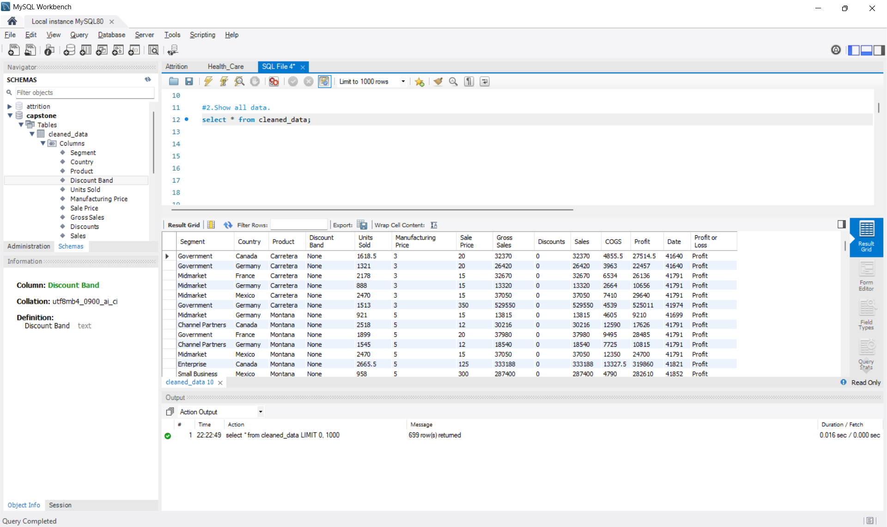
Verify if the data is properly imported into the SQL database (Try running few Queries.)

Slide 9
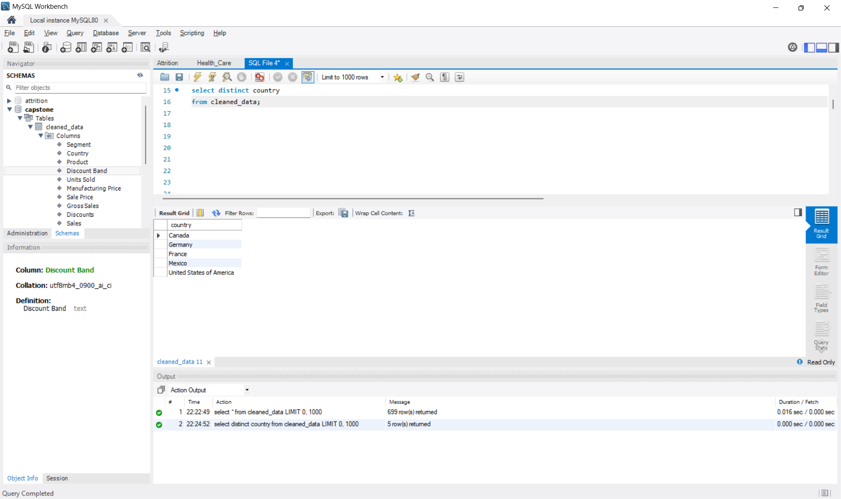

Slide 10
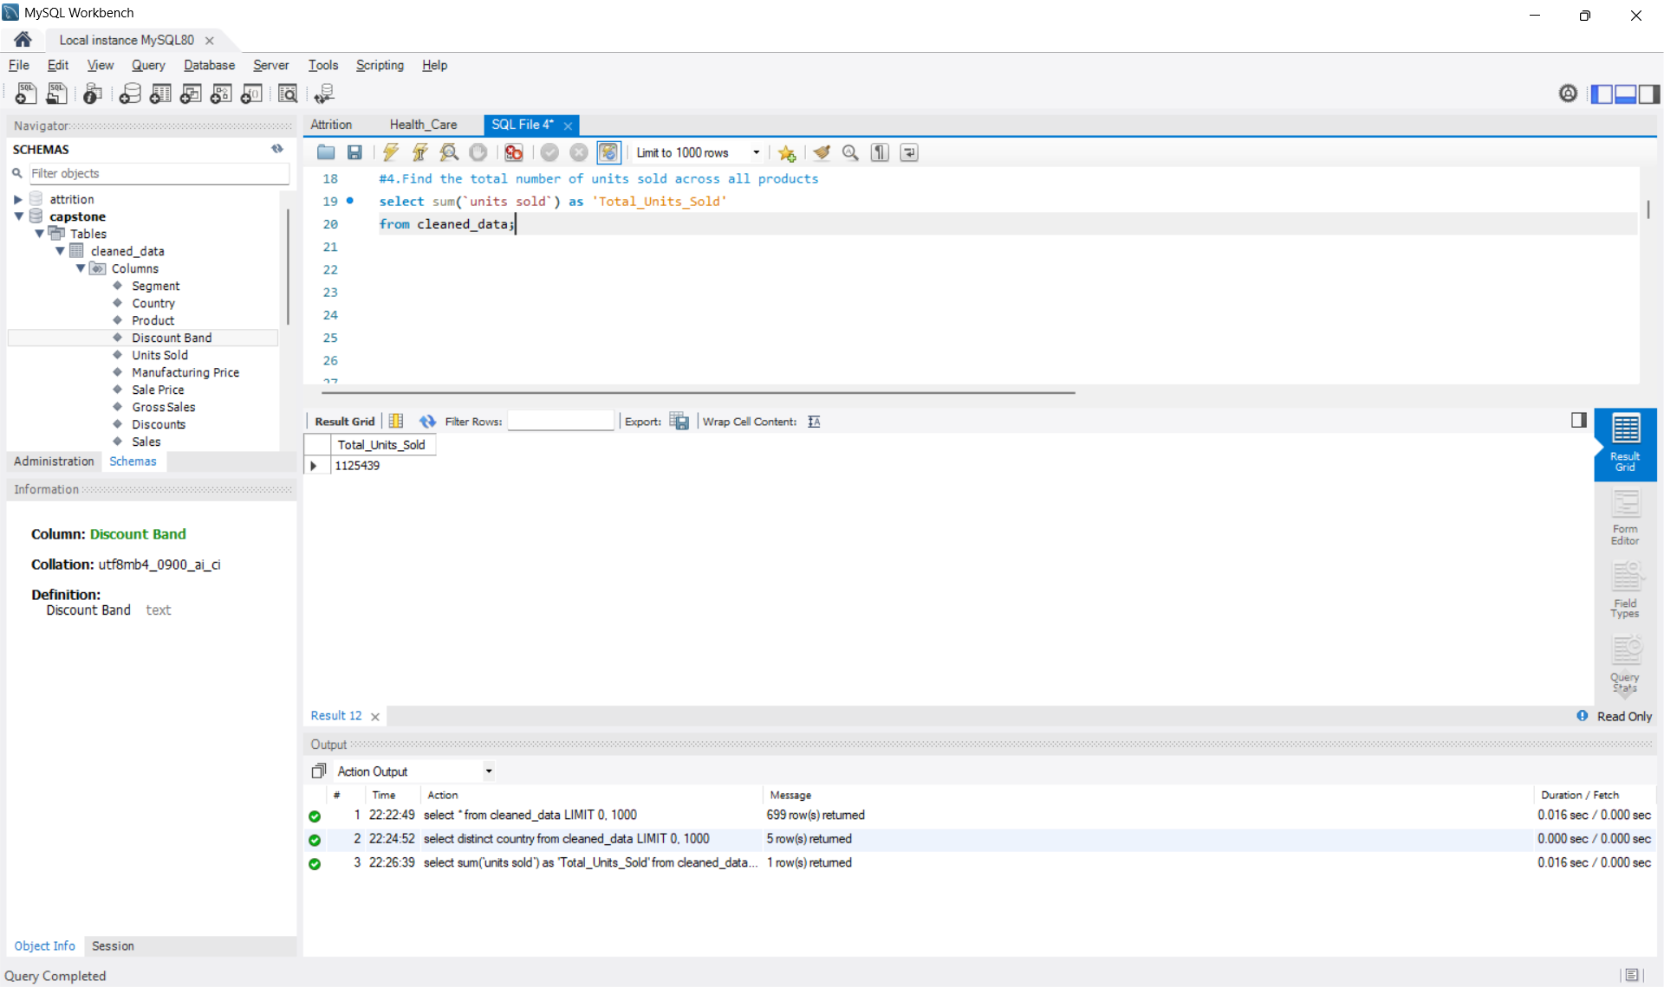

Slide 11
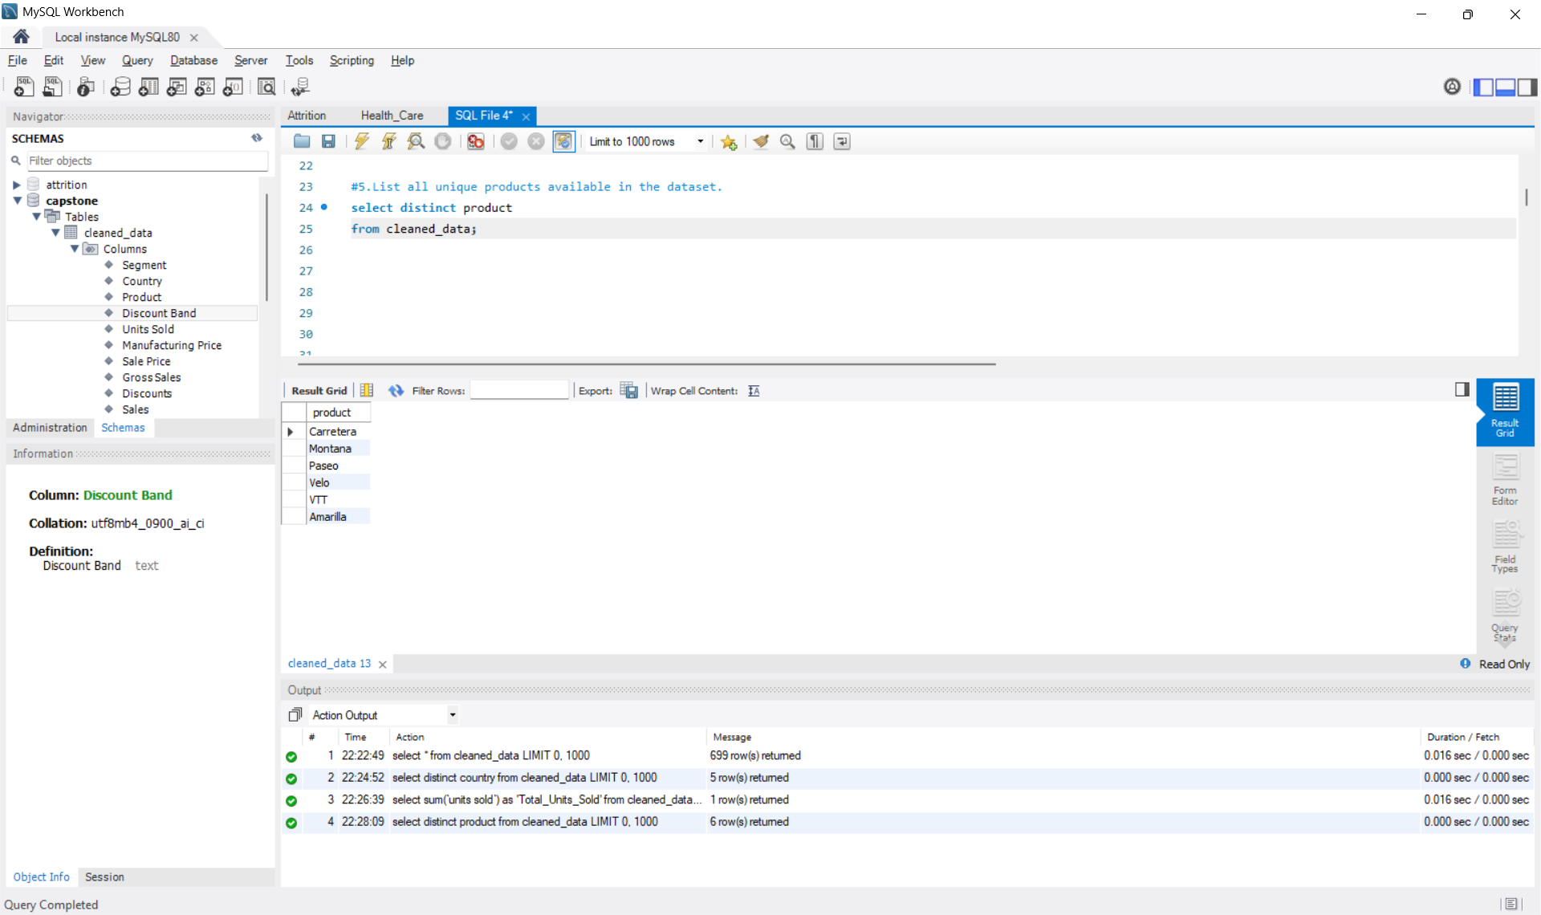

Slide 12
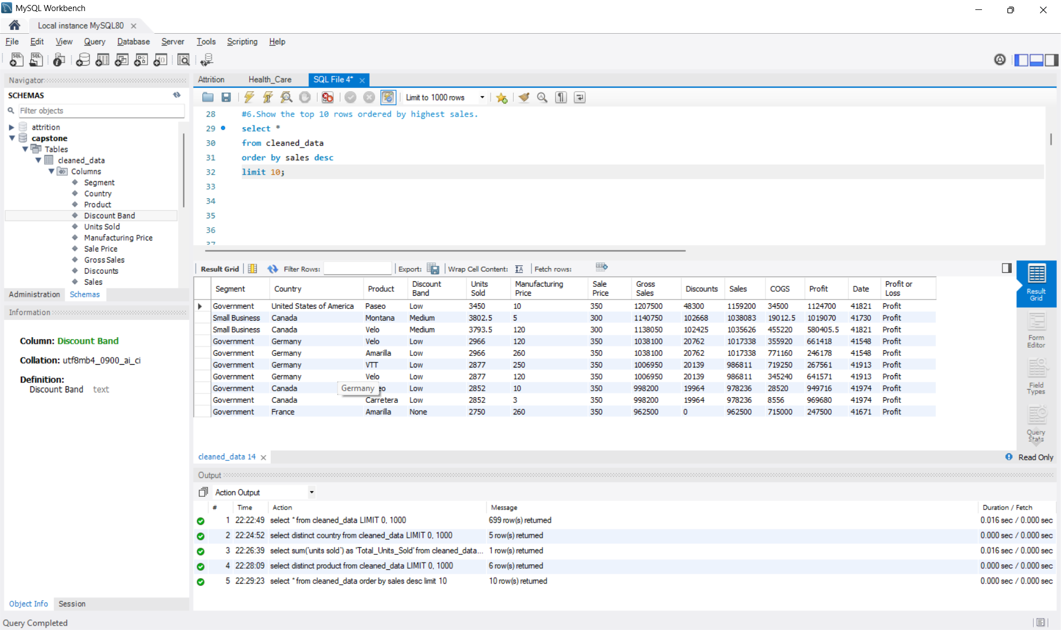

Slide 13
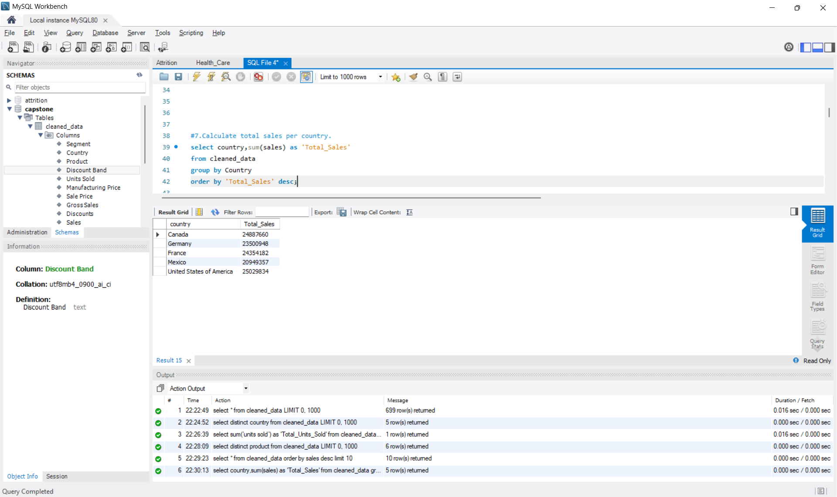

Slide 14
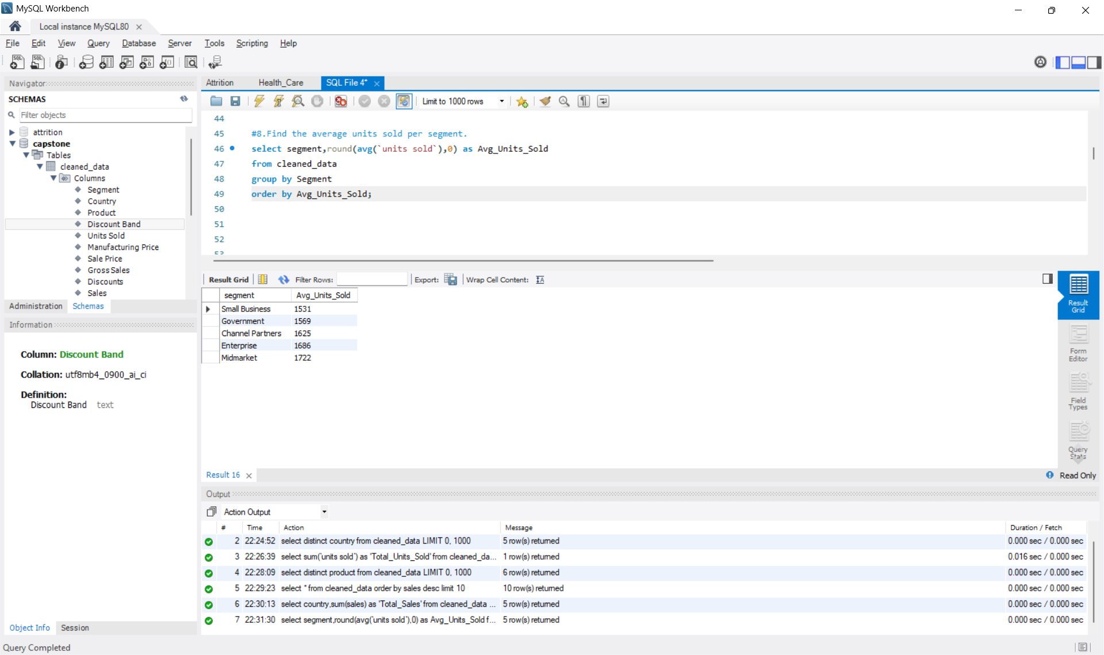

Slide 15
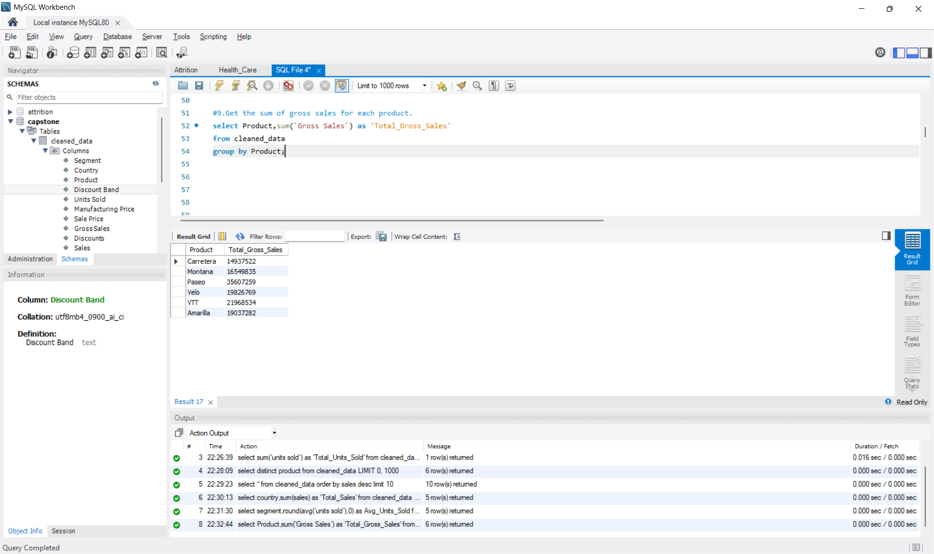

Slide 16
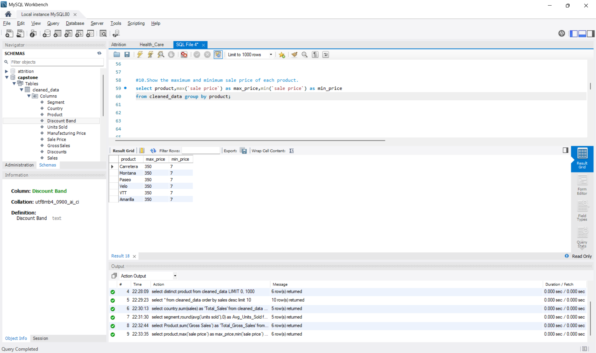

Slide 17
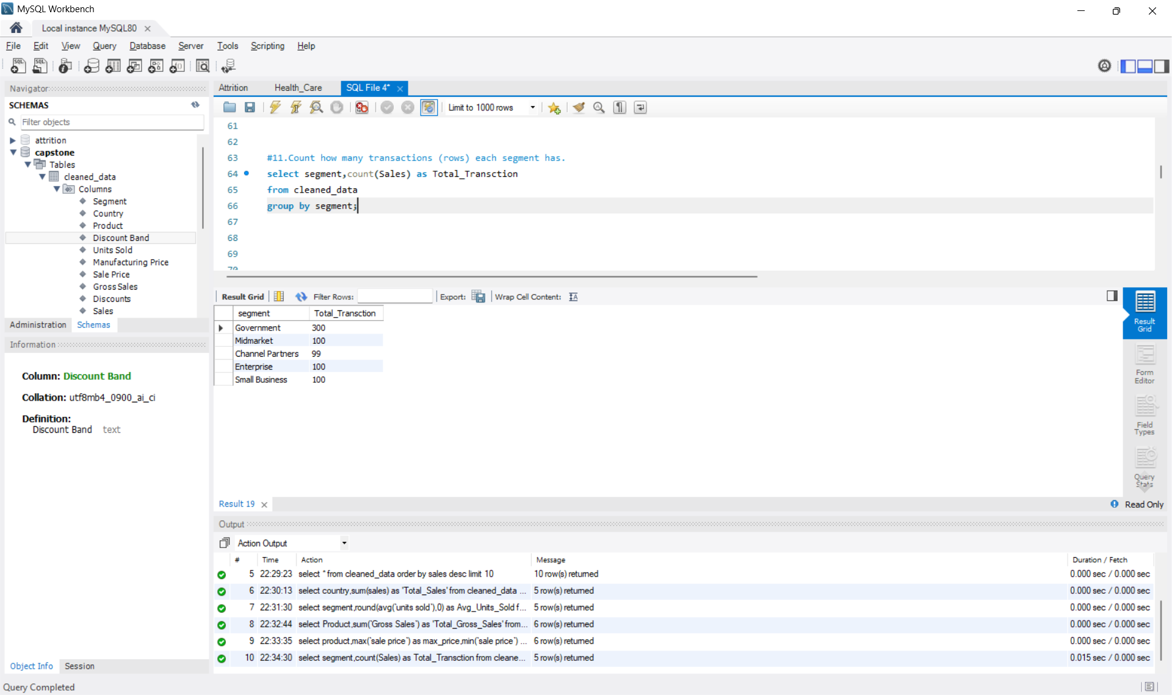

Slide 18
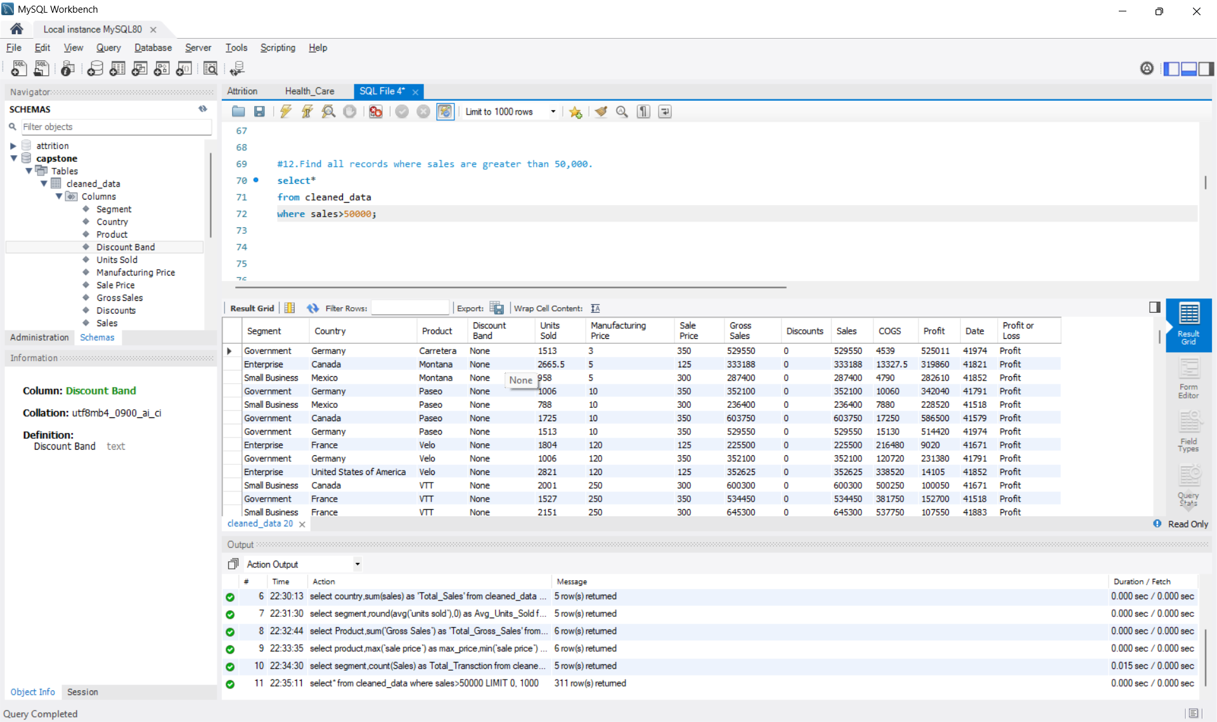

Slide 19
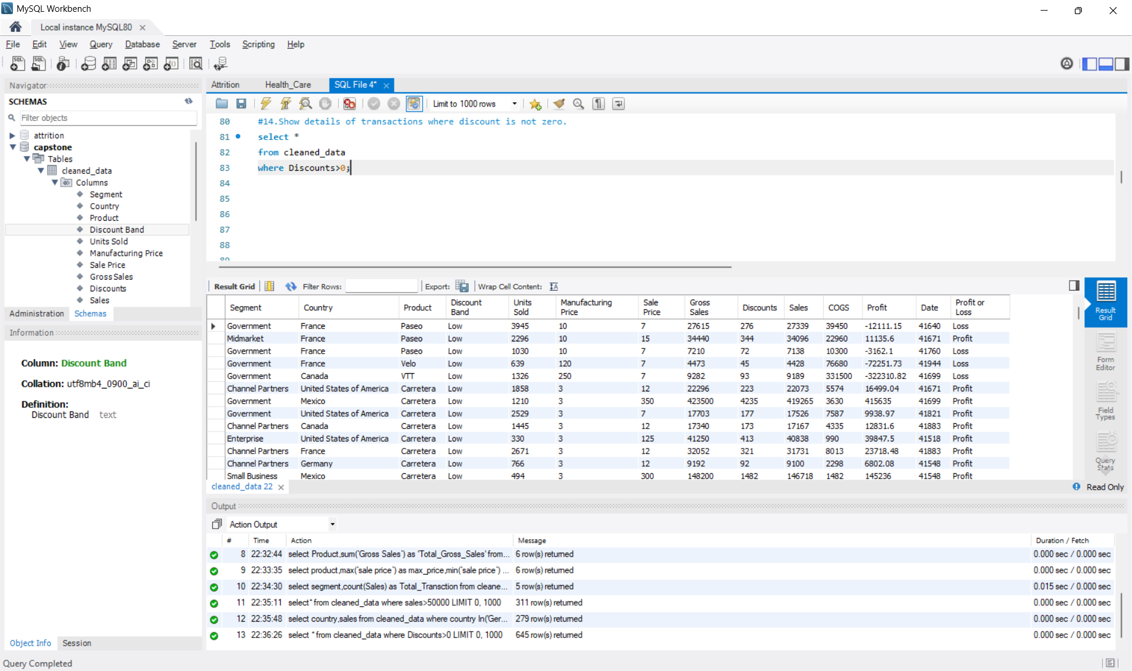

Slide 20
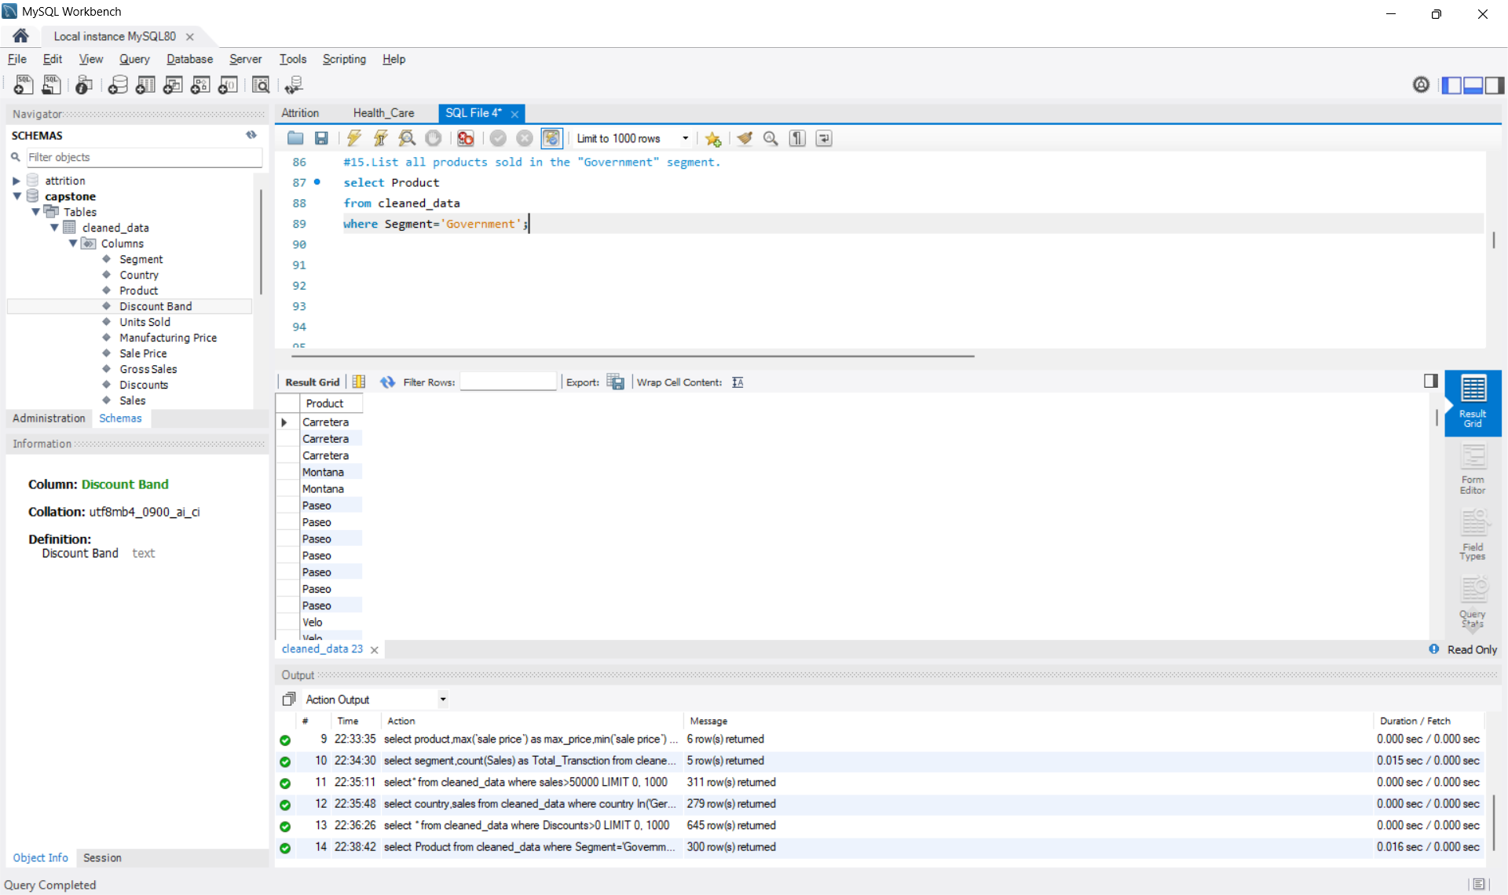

Slide 21
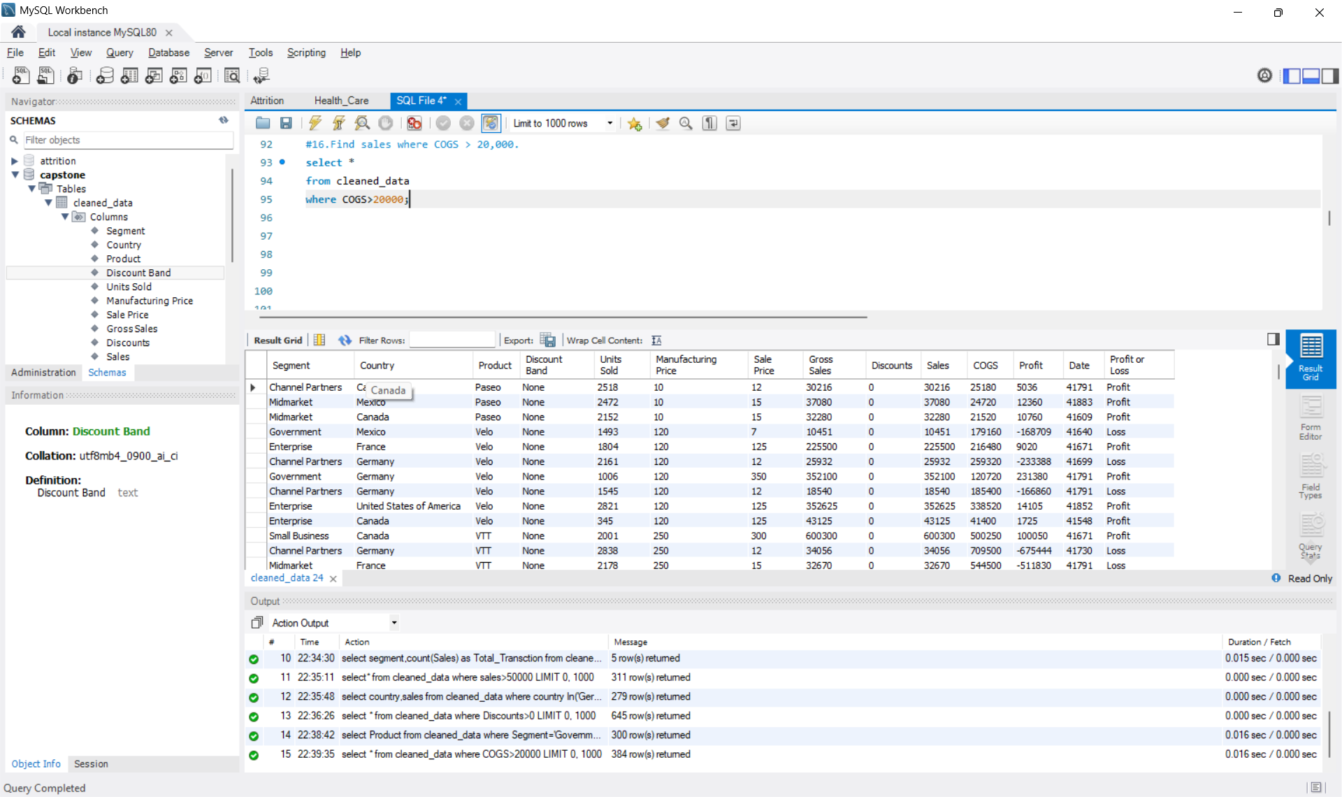

Slide 22
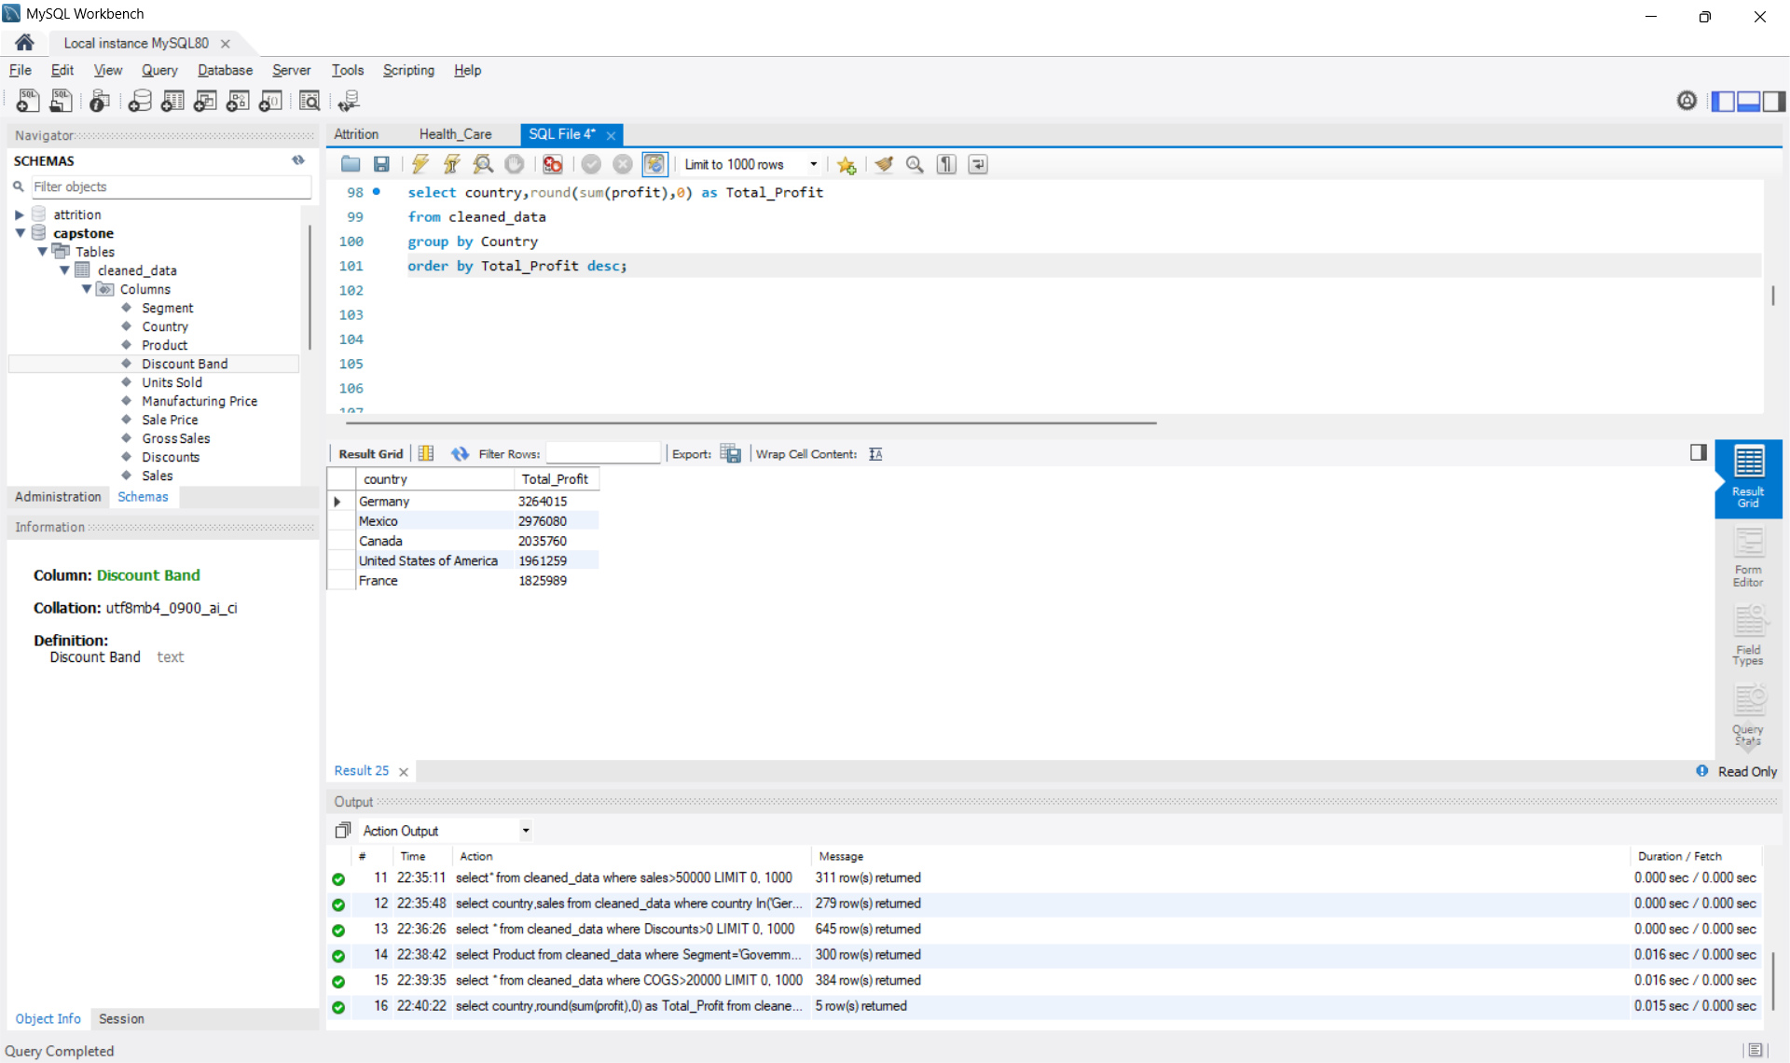

Slide 23
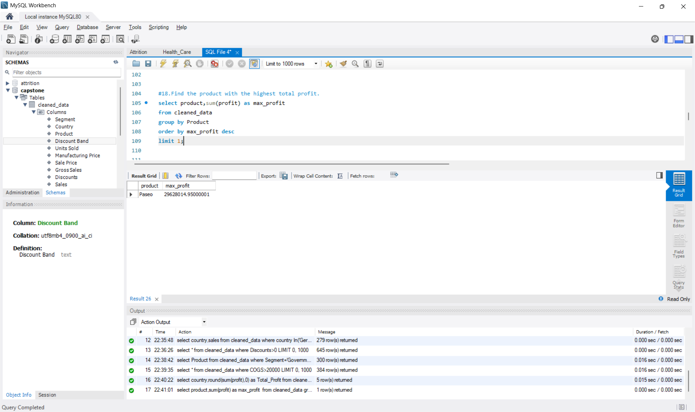

Slide 24
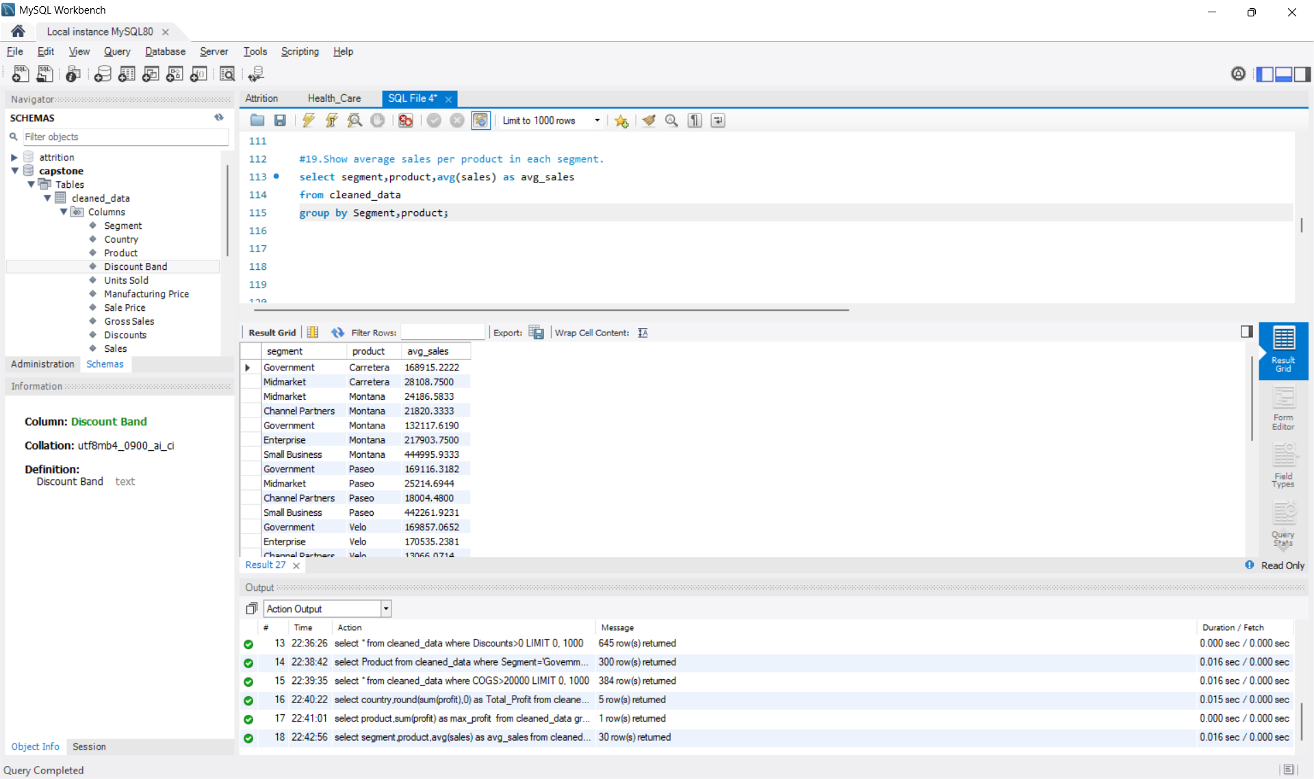

Slide 25
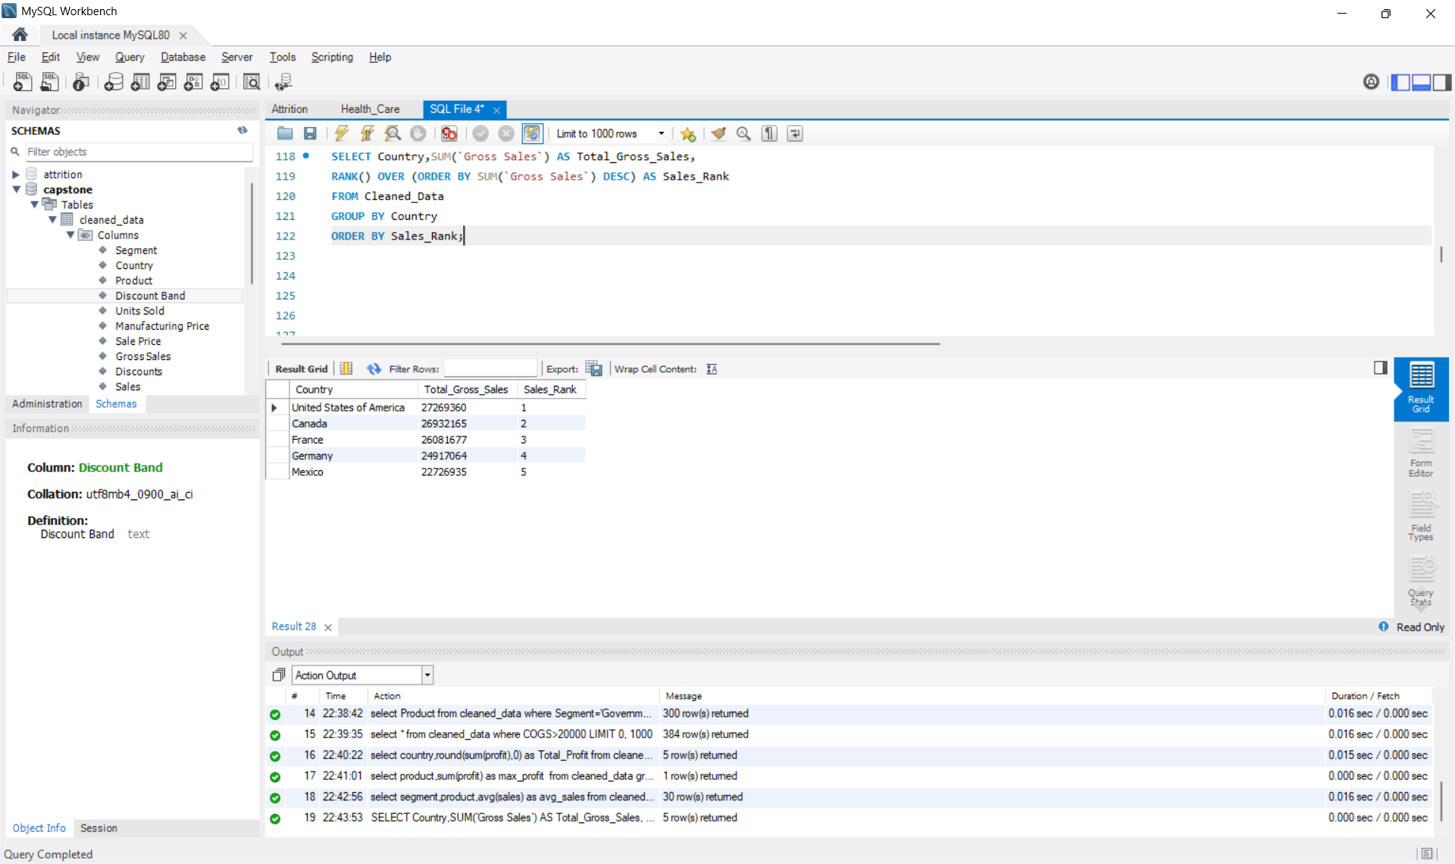

Slide 26
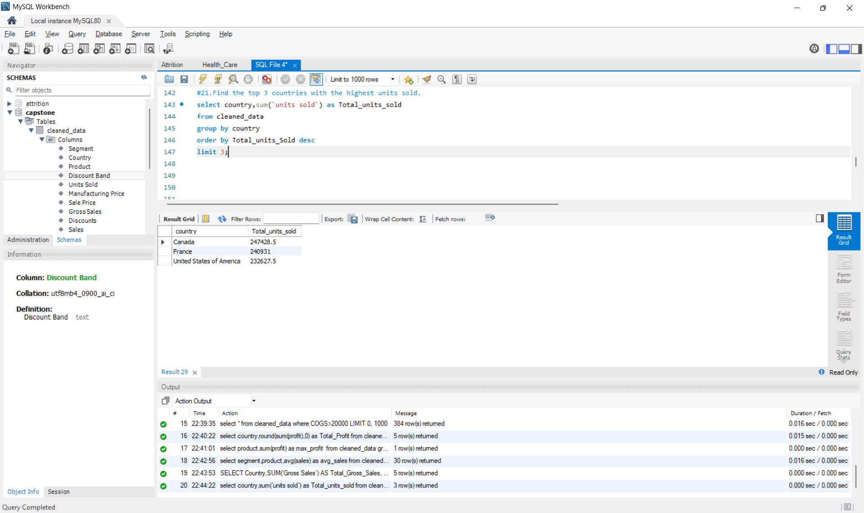

Slide 27
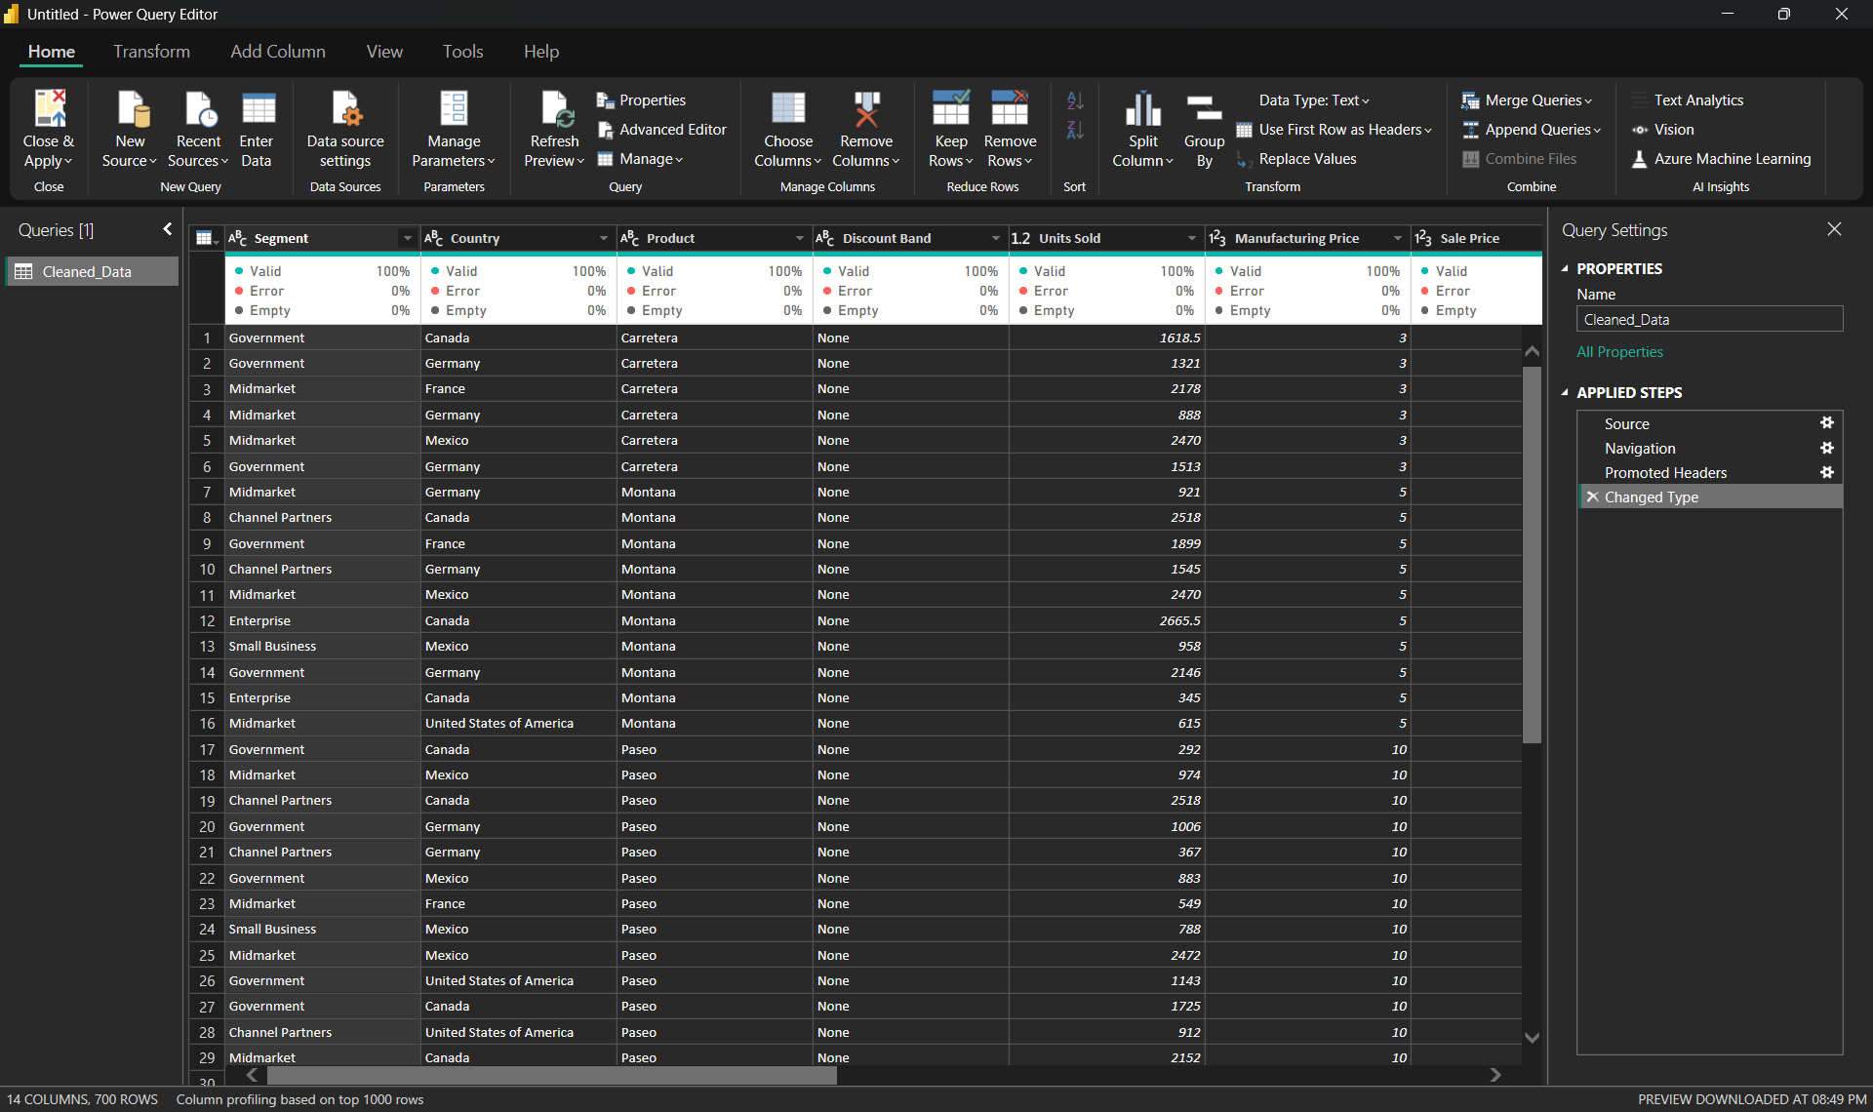
Import the Data from the SQL Database into Power BI, verify if the data is properly imported or not.

Slide 28
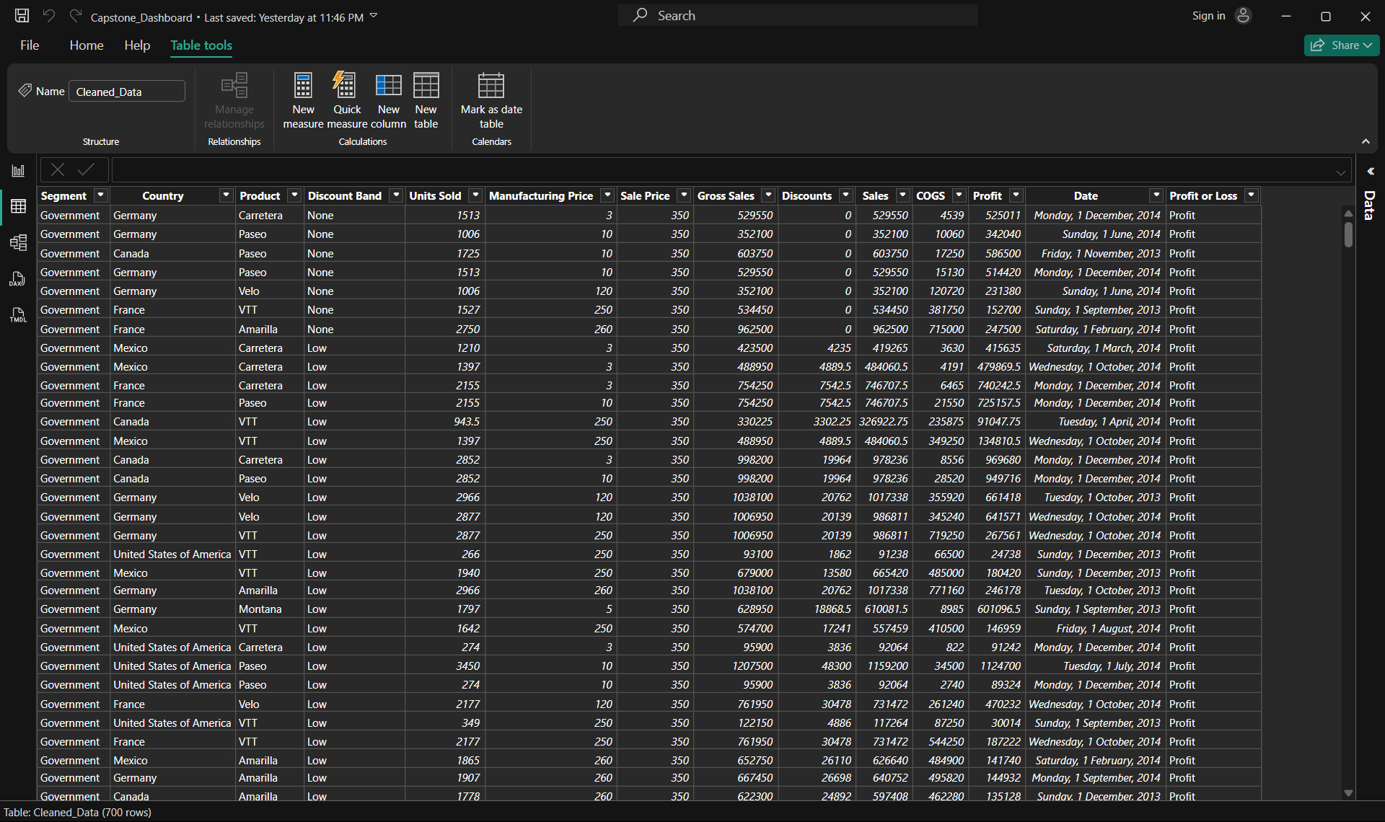
Perform Data cleaning and other possible operations on data using query editor, create measures if necessary and use them to Visualize the data and make an interactive visualization.

Slide 29
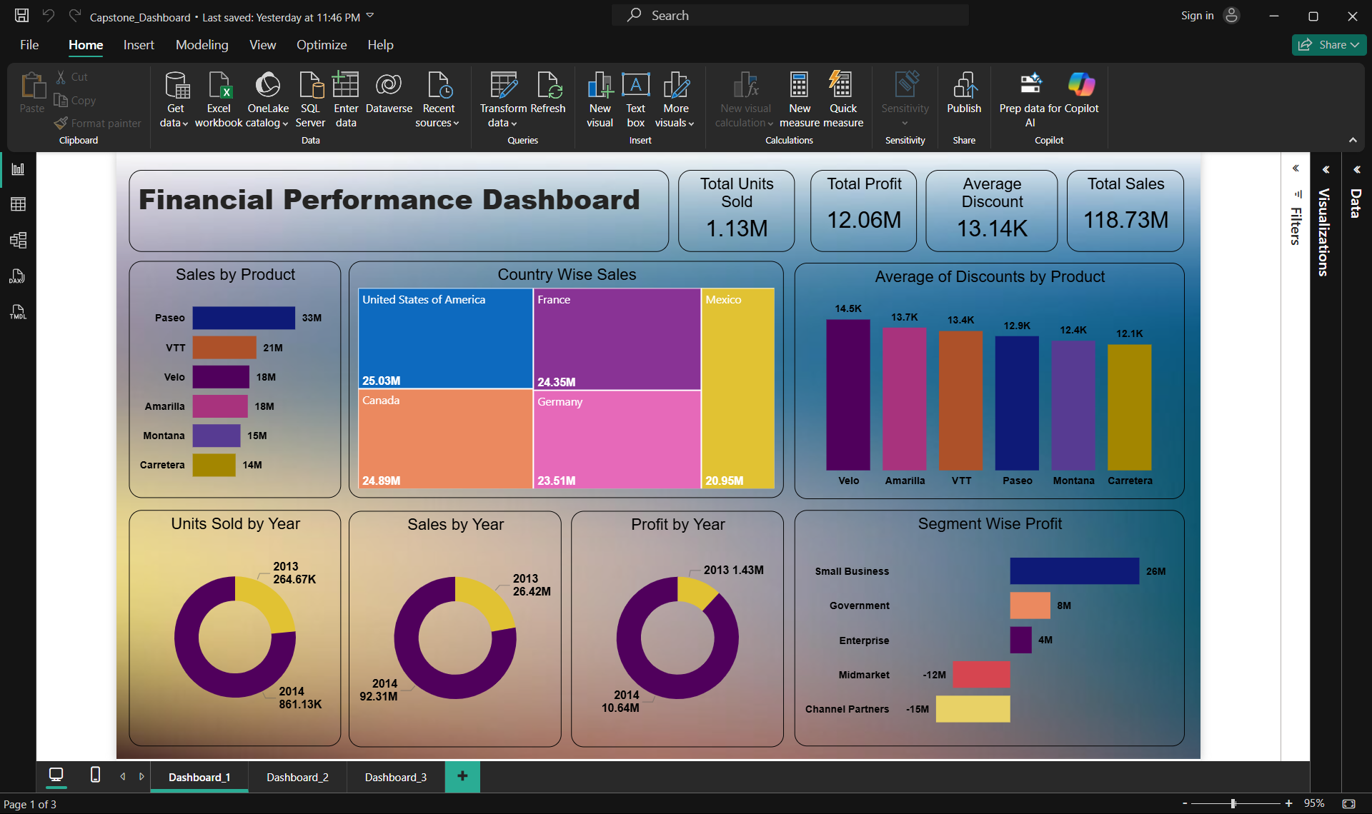
Create a Visually pleasing Dashboard report by following the rules of making the Dashboard.

Slide 30
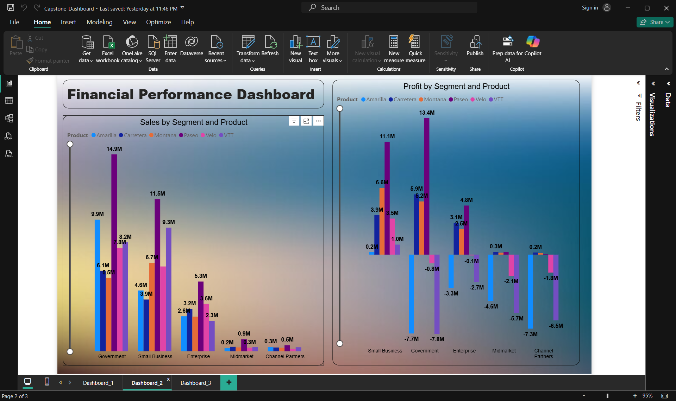

Slide 31
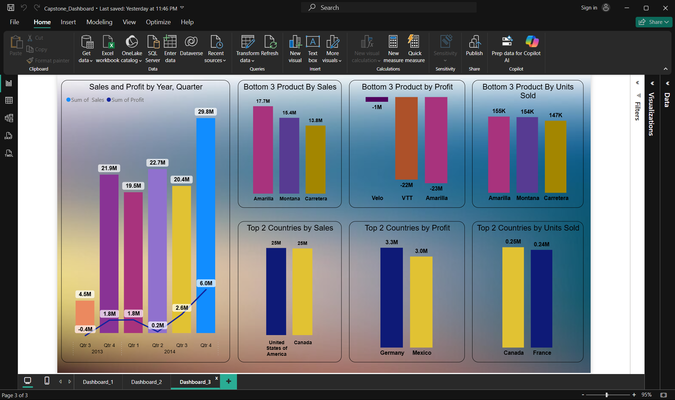

Slide 32
Derive Conclusion and Inferences from the Dashboard.
Executive snapshot
Scale: 1.13M units → $118.73M sales → $12.06M profit (≈ 10.2% margin; ≈ $105 revenue & $10.7 profit per unit).
Momentum: 2014 vs 2013 — Sales +249% (26.4M → 92.3M), Profit +644% (1.43M → 10.64M). Margin nearly doubled (5.4% → 11.5%).
Where money is made: Germany (3.3M) and Mexico (3.0M) are the top profit countries, not the top revenue ones. Margin pressure likely in USA/Canada.
What’s hurting: Two products—Amarilla (-23M) and VTT (-22M)—erase a massive chunk of profit despite strong sales.
Growth & seasonality
Best quarter: Q4-2014 with $29.8M sales and $6.0M profit—a clear peak.
Weakest quarter: Q3-2013 with a loss of ~$0.4M.
Watch Q2-2014: strong sales ($22.7M) but almost no profit (~$0.2M) → likely heavy discounting/promo or cost spike.

Slide 33
Derive Conclusion and Inference from the Dashboard.
Geography
Revenue is balanced across the top 5: USA (25.0M), Canada (24.9M), France (24.4M), Germany (23.5M), Mexico (21.0M).
Profit leaders: Germany and Mexico; yet sales leaders are USA & Canada. → NA mix/discounts seem unfavorable vs EU/LatAm.
Units sold leaders: Canada (~250K) and France (~240K) → high volume, but not top profit; margins may be thin.
Segment profitability (big lever)
Small Business is the engine: +26M profit.
Government +8M, Enterprise +4M (healthy).
Midmarket (-12M) and Channel Partners (-15M) are deeply loss-making. → If you simply brought these two to break-even, total profit would jump from ~12M to ~39M (order-of-magnitude impact).

Slide 34
Derive Conclusion and Inferences from the Dashboard.
Segment profitability (big lever)
Small Business is the engine: +26M profit.
Government +8M, Enterprise +4M (healthy).
Midmarket (-12M) and Channel Partners (-15M) are deeply loss-making. → If you simply brought these two to break-even, total profit would jump from ~12M to ~39M (order-of-magnitude impact).
Product performance & discounting
Top seller: Paseo $33M (≈28% of revenue). Then VTT $21M, Velo/Amarilla $18M each, Montana $15M, Carretera $14M.
But: Bottom by profit are Amarilla (-23M), VTT (-22M), Velo (-1M) → high-selling SKUs destroying value.
Discount signal: Highest average discounts are Velo (14.5K), Amarilla (13.7K), VTT (13.4K); the lowest is Carretera (12.1K). The three heaviest-discounted products are the least profitable, implying over-discounting or wrong pricing/costing.
Within segments, product profitability swings wildly (e.g., a product shows +11.1M in one segment but large negatives in others). → Product x may be great for Government/Small Business but toxic in Midmarket/Channel Partners. Optimize product–segment fit.

Slide 35
Derive Conclusion and Inferences from the Dashboard.
Unit economics & mix
2014 accounts for ~76% of units (861K/1.13M). Growth is volume-led and margin-accretive — a good sign.
Bottom-3 by units: Amarilla (155K), Montana (154K), Carretera (147K)—but “low units” doesn’t equal “bad”: Carretera likely earns better margins (lowest discount, not in the loss list).
Likely root causes (what the visuals suggest)
Over-discounting on specific SKUs (Amarilla, VTT, Velo), especially in Midmarket and Channel Partners.
Country mix issues—USA/Canada drive volume but carry lower margins vs Germany/Mexico (pricing, freight, or product mix).
Segment misfit—selling the wrong SKUs in Midmarket/Channel Partners

